Slide 1
Debugging em Docker Container de IDE Local
Allan Gurwicz — agurwicz@ele.puc-rio.br
github.com/agurwicz/docker-ssh

Slide 2




Situação Atual
ssh
qsub
docker run
Ícones feitos por Freepik, Becris e Smartline de www.flaticon.com

Slide 3
Situação Desejada
IDE
Ícones feitos por Freepik, Becris e Smartline de www.flaticon.com

Slide 4
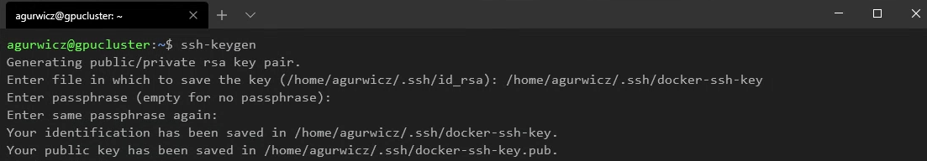
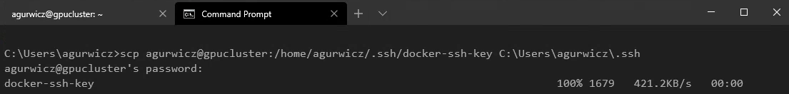
Criação de Chave de SSH
cluster$ ssh-keygen
cluster$ cat <path_to_key>.pub >> ~/.ssh/authorized_keys
local_machine> scp <user>@<cluster_ip>:<path_to_key> <directory_in_local_machine>

Slide 5
Criação de Docker Image
scripts/ssh_dockerfile.sh & scripts/create_image.sh
https://github.com/agurwicz/docker-ssh/blob/master/scripts/ssh_dockerfile.sh
https://github.com/agurwicz/docker-ssh/blob/master/scripts/create_image.sh

Slide 6
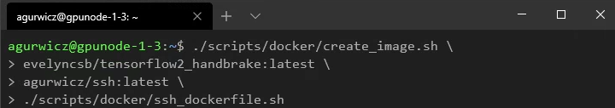
Criação de Docker Image
node$ <path_to_script>/create_image.sh <base_image_name> <image_name> <dockerfile_path>
node$ docker image list | grep <image_name>

Slide 7
Criação de Docker Container
scripts/create_container.sh
https://github.com/agurwicz/docker-ssh/blob/master/scripts/create_container.sh

Slide 8
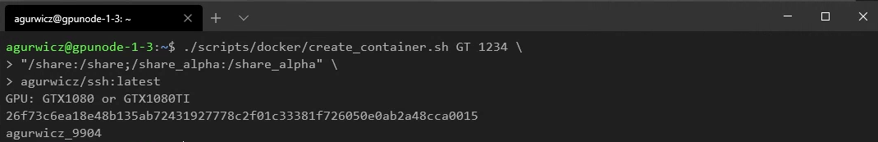
Criação de Docker Container
node$ <path_to_script>/create_container.sh <gpu> <port> <mapped_directories> <image_name>
node$ docker ps | grep <container_name>
node$ docker exec -it <container_name> /bin/bash
ou
node$ ssh -p <port> -i "<path_to_ssh_key>" ${USER}@127.0.0.1

Slide 9
Túnel de SSH
scripts/ssh_tunnel.bat
https://github.com/agurwicz/docker-ssh/blob/master/scripts/ssh_tunnel.bat

Slide 10
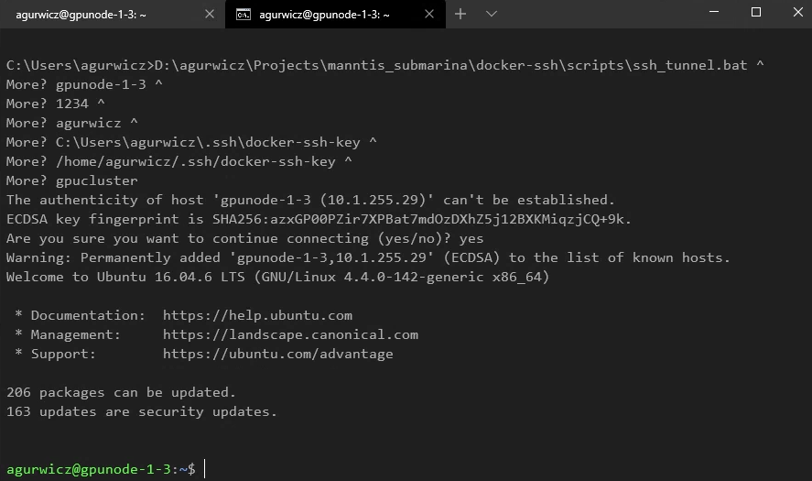
Túnel de SSH
local_machine> <path_to_script>\ssh_tunnel.bat <node_ip> <port> <user> <local_key_path> <remote_key_path> <remote_ip>

Slide 11
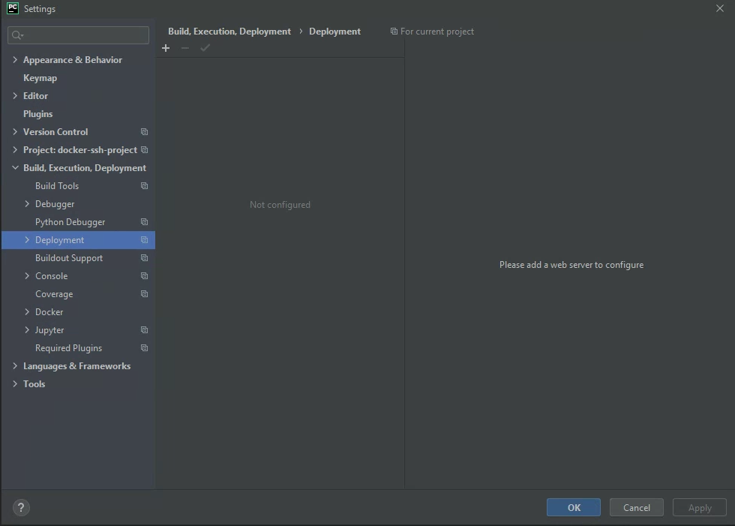
Configuração de IDE: PyCharm Professional
File >
Settings >
Build, Execution, Deployment >
Deployment

Slide 12
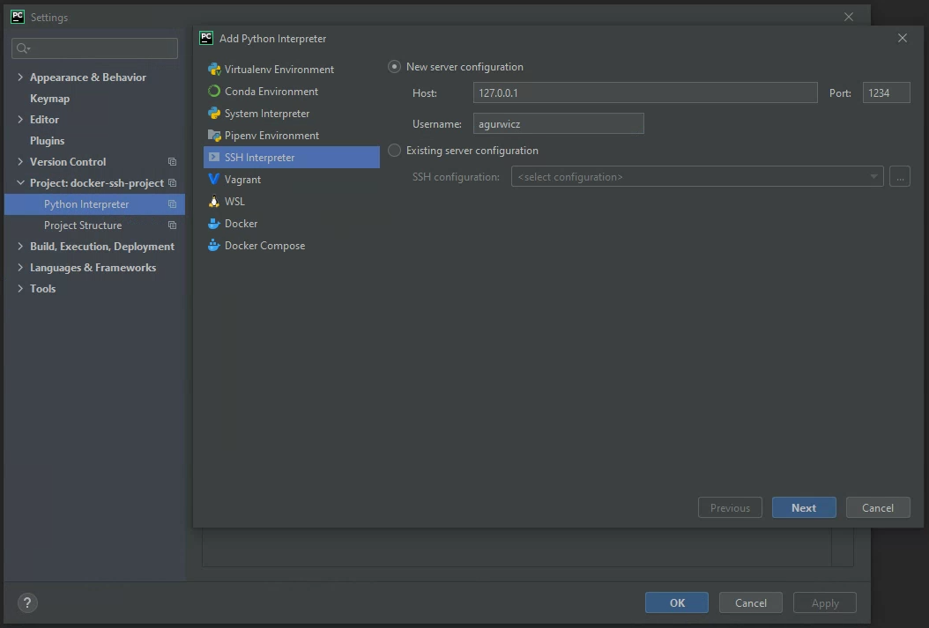
Configuração de IDE: PyCharm Professional
File >
Settings >
Project: <project_name> >
Python Interpreter >
⚙ >
Add >
SSH Interpreter >
New server configuration

Slide 13
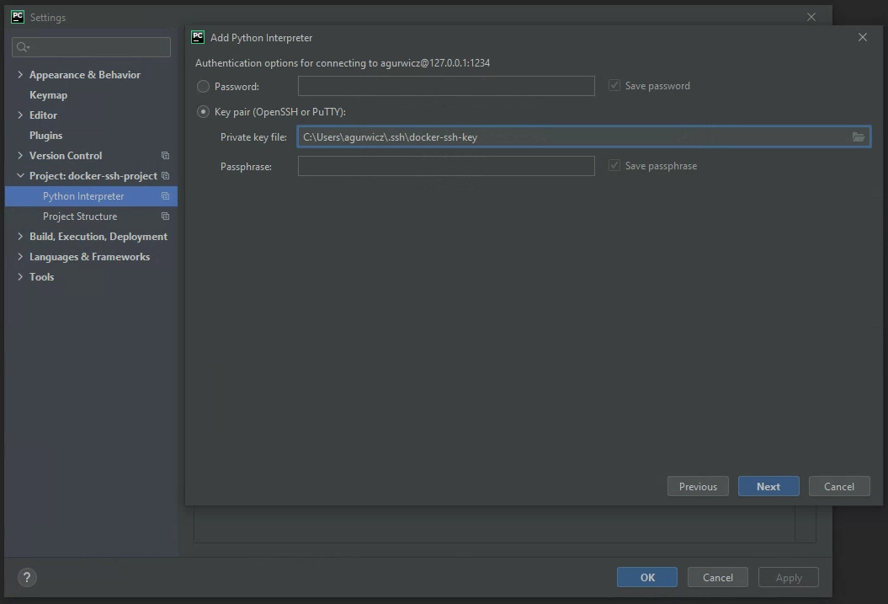
Configuração de IDE: PyCharm Professional
File >
Settings >
Project: <project_name> >
Python Interpreter >
⚙ >
Add >
SSH Interpreter >
New server configuration

Slide 14
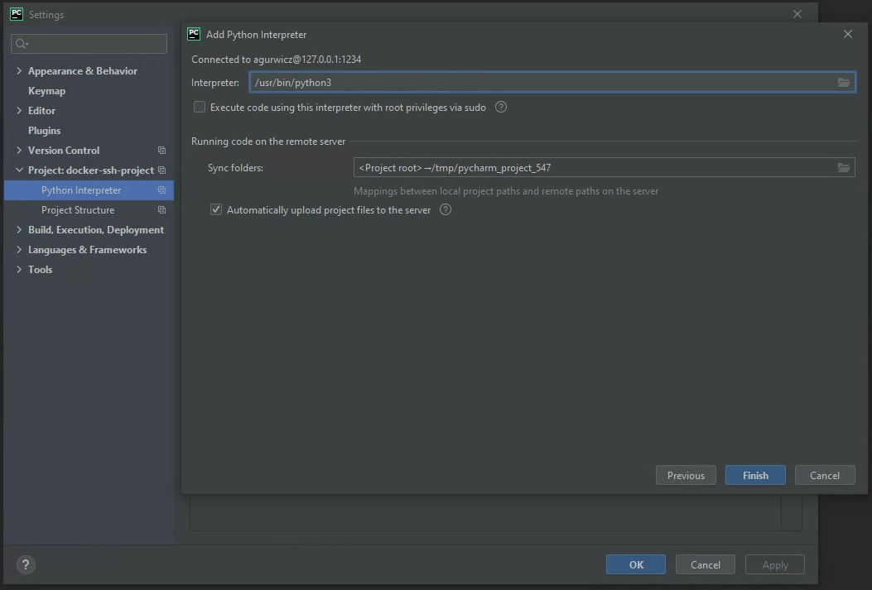
Configuração de IDE: PyCharm Professional
File >
Settings >
Project: <project_name> >
Python Interpreter >
⚙ >
Add >
SSH Interpreter >
New server configuration

Slide 15
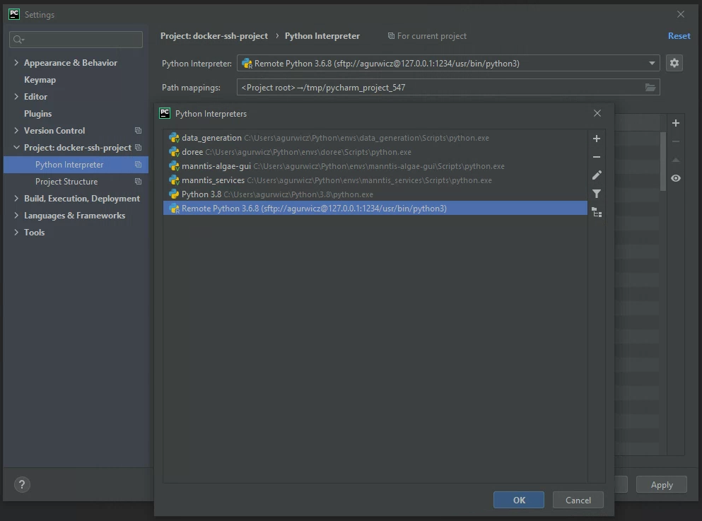
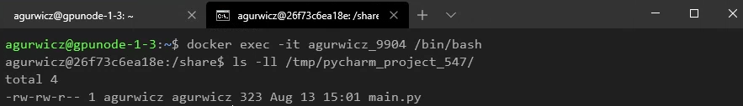
Configuração de IDE: PyCharm Professional
File >
Settings >
Project: <project_name> >
Python Interpreter >
⚙ >
Add >
SSH Interpreter >
New server configuration

Slide 16
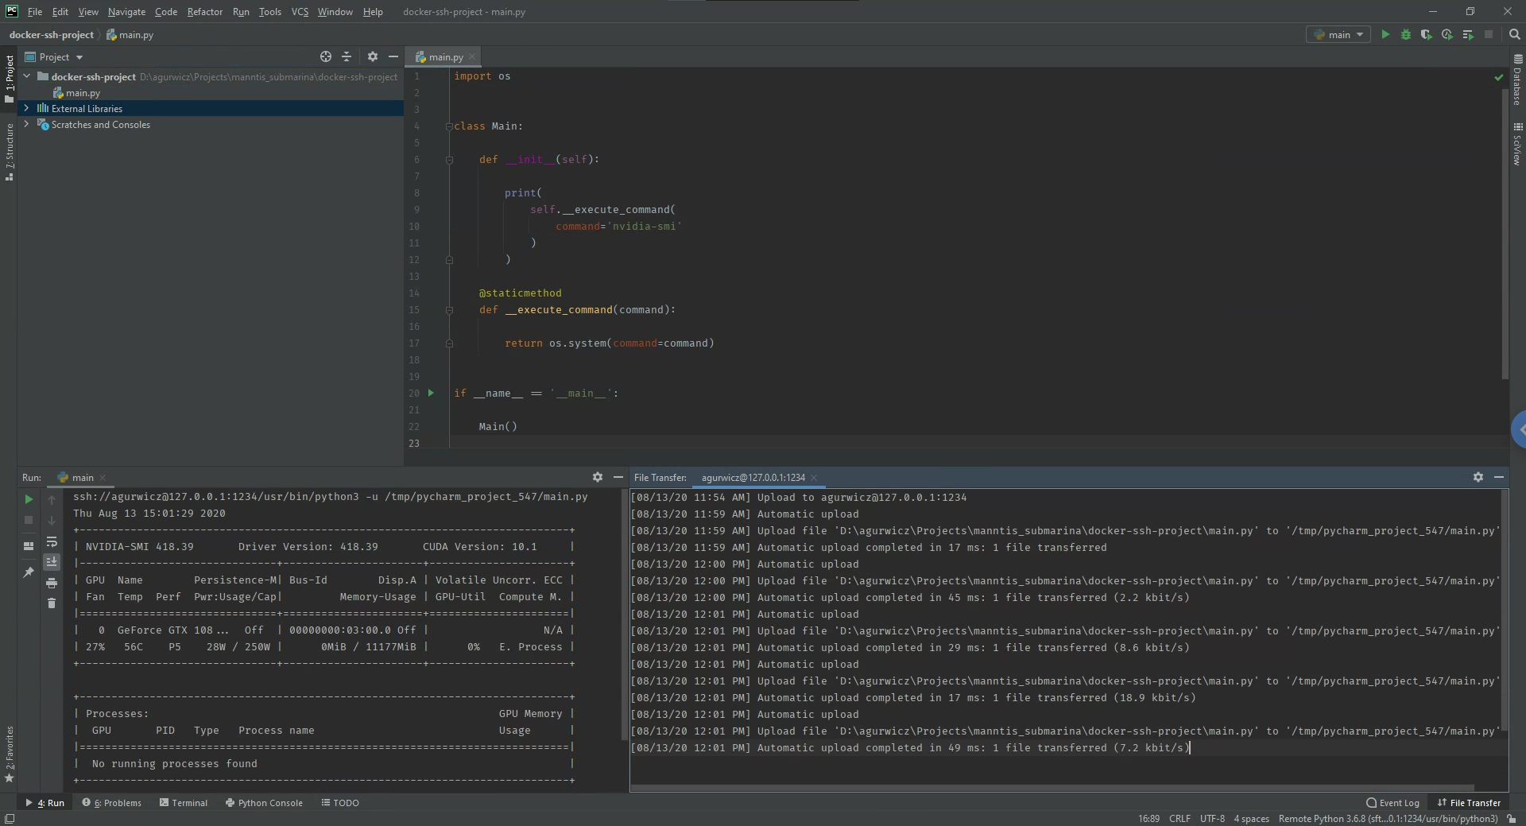

Slide 17
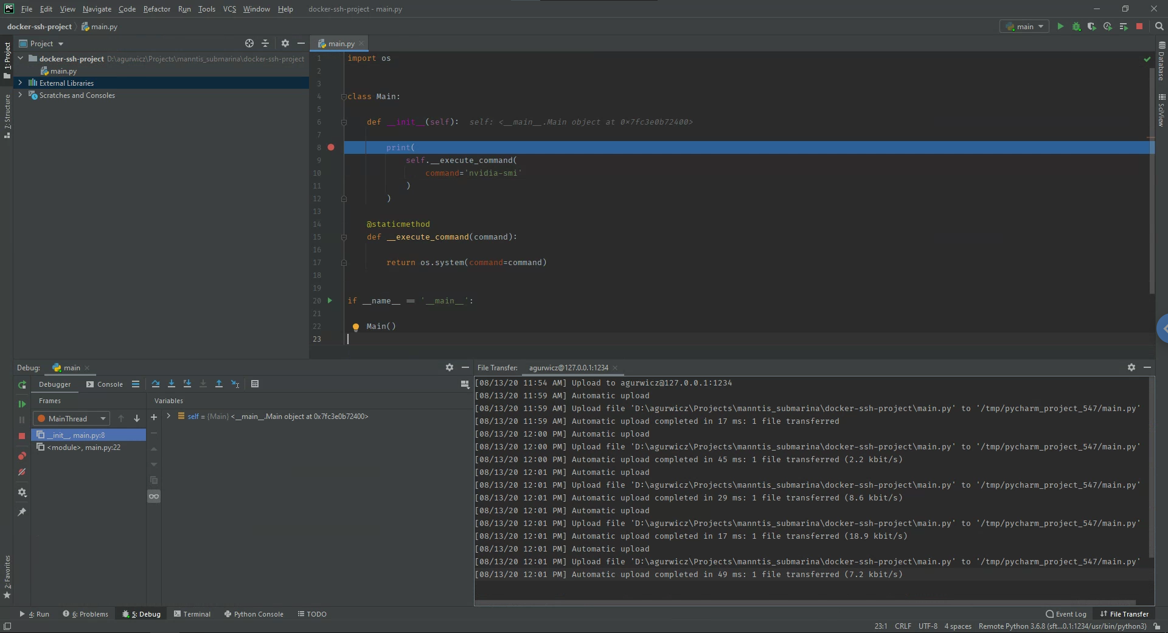

Slide 18
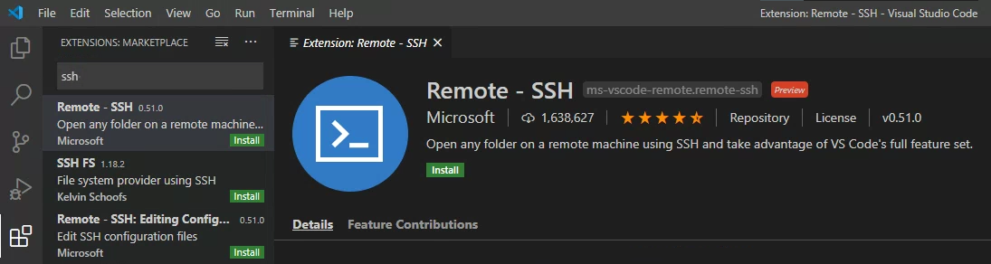
Configuração de IDE: Visual Studio Code
View >
Extensions >
“Remote - SSH” >
Install

Slide 19
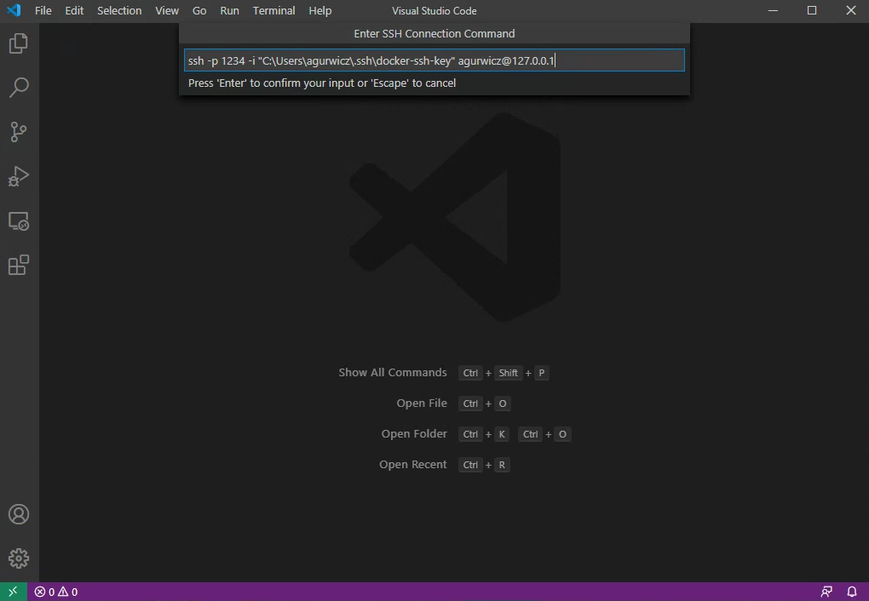
Configuração de IDE: Visual Studio Code
“><” >
Remote-SSH: Connect to Host… >
Add New SSH Host… >
ssh -p <port> -i "<path_to_ssh_key>" <user>@127.0.0.1

Slide 20
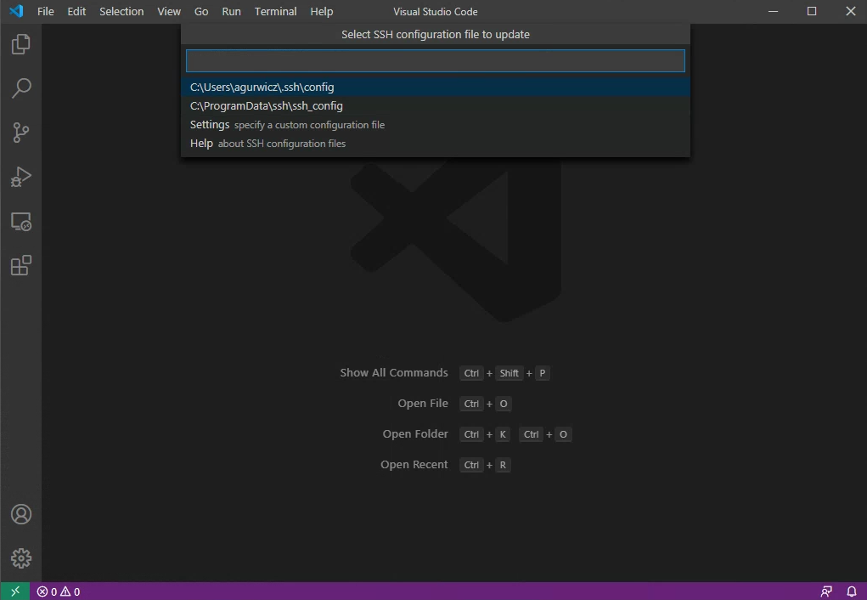
Configuração de IDE: Visual Studio Code
“><” >
Remote-SSH: Connect to Host… >
Add New SSH Host… >
ssh -p <port> -i "<path_to_ssh_key>" <user>@127.0.0.1

Slide 21
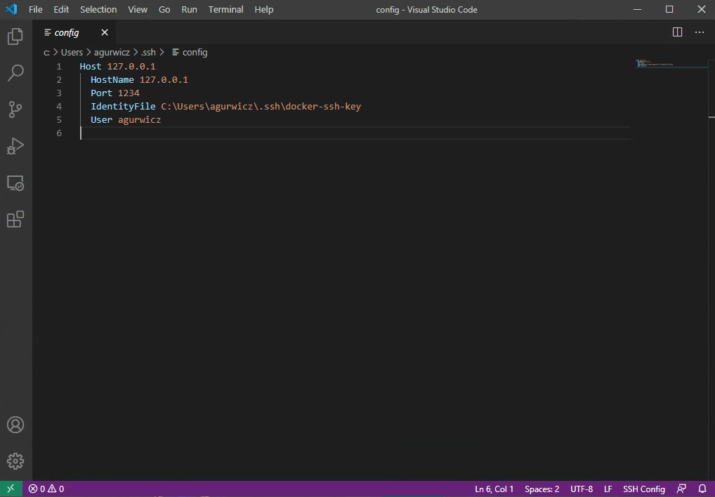
Configuração de IDE: Visual Studio Code
“><” >
Remote-SSH: Connect to Host… >
Add New SSH Host… >
ssh -p <port> -i "<path_to_ssh_key>" <user>@127.0.0.1

Slide 22
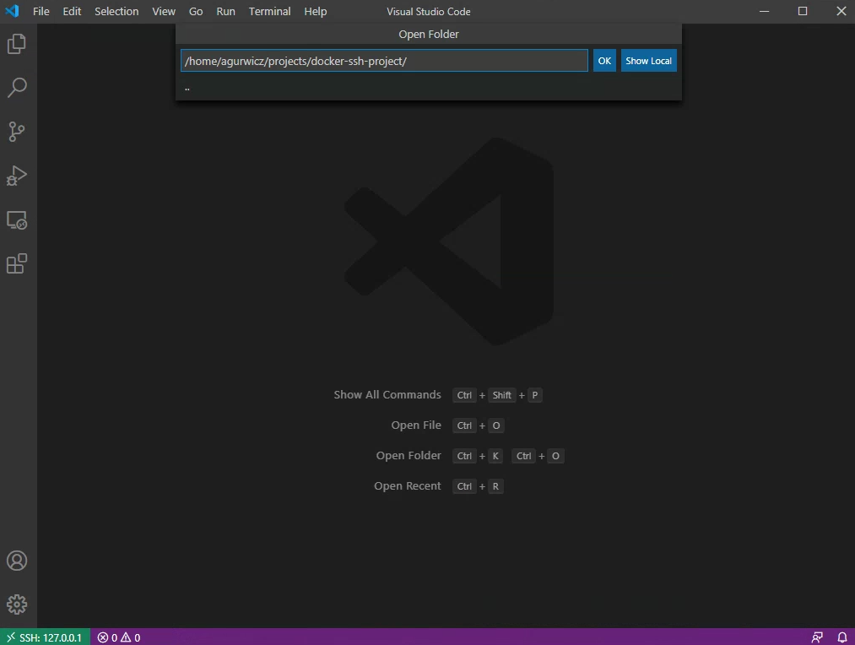
Configuração de IDE: Visual Studio Code
File >
Open Folder…

Slide 23
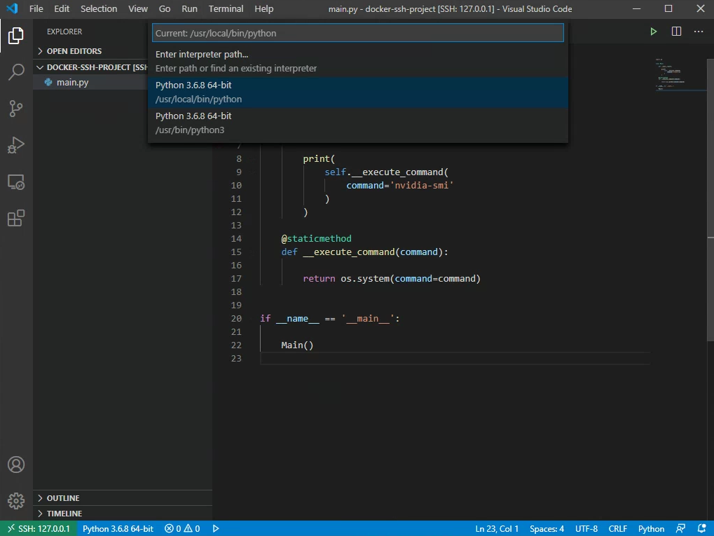
Configuração de IDE: Visual Studio Code
Python

Slide 24
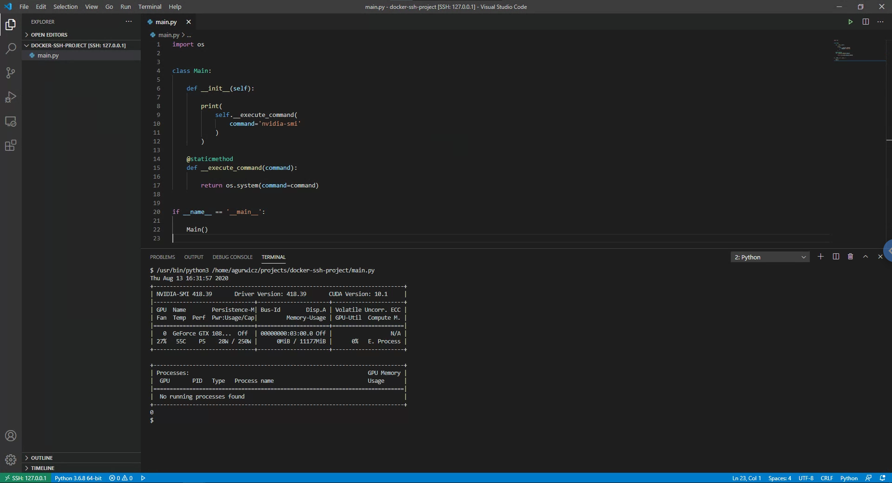

Slide 25
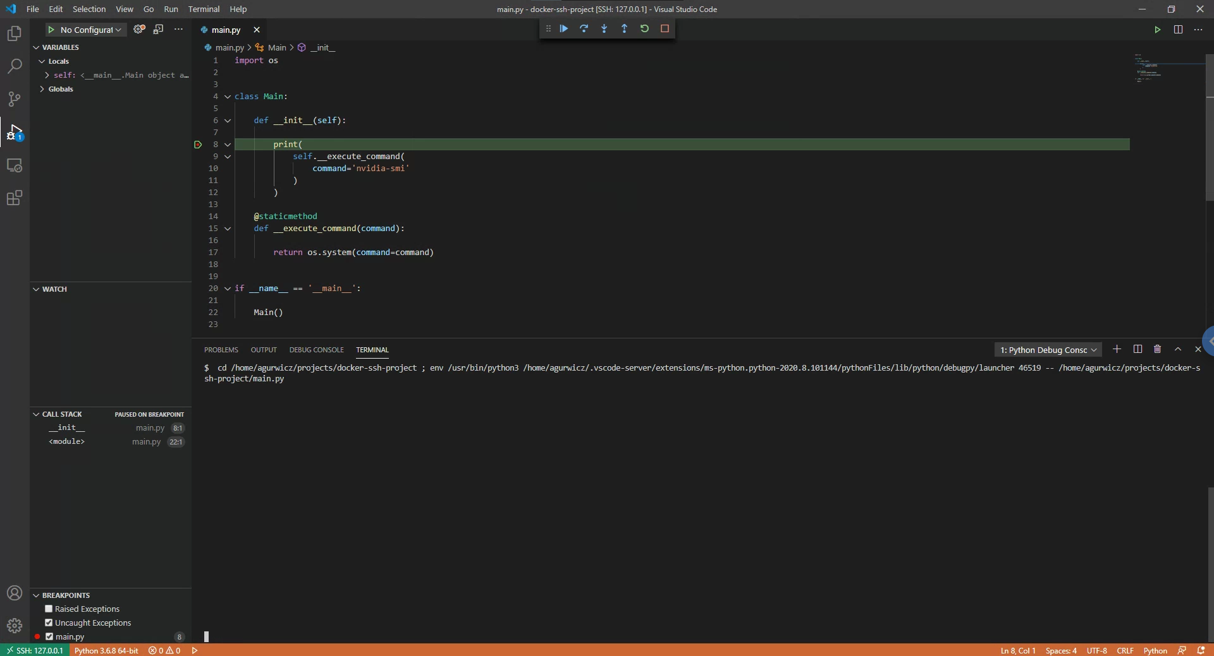

Slide 26
Problemas/Melhorias
Issues: https://github.com/agurwicz/docker-ssh/issues
Forks & Pull Requests!
Dúvidas?

